Slide 1
Технологии разработки ПО / Software Engineering
Weekly report <Application for Transport document creation>
<Naveen, Programmer >
<04.03.2021>

Slide 2
Project CHARTER
Project goals and vision
Application runs smoothly
Bugs free
User friendly
Light weight
Project description
Android application for e-way bill
Registration of Driver with details
Driver can get details of goods
Acknowledgement by Driver

Slide 3
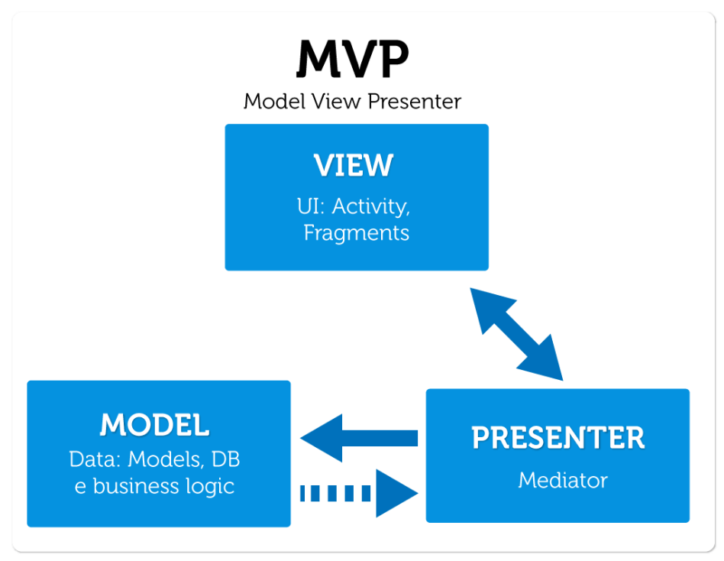
Architecture, high level design
Architecture

Slide 4
Architecture (MVP)
Model: the data layer
View: the UI layer, displays data received from Presenter, reacts to user input. On Android, we treat Activities, Fragments, and android.view.View as View from MVP.
Presenter: responds to actions performed on the UI layer, performs tasks on Model objects (using Use Cases), passes results of those tasks to Views

Slide 5
Technologies
Java
XML
Firebase

Slide 6
Organizational Structure
Customer
< Evgeny Filippov >
< Alexander Eroshkin >
Project/Delivery Manager
<Naveen>
Team <V.A.N.>
Team Lead <Naveen>
Analysts: Chubchik Alexander
Developers:Naveen, Ryleev Vladislav
Testers: Chubchik Alexander
CMs: Naveen, Chubchik Alexander
Notes:
CRM – customer relationship manager / teacher

Slide 7
Communication Model
Using Email
Vk

Slide 8
Key Accomplishments For Reporting Period
Kick off meeting
Statement of work
Design Main activity and Registration activity

Slide 9
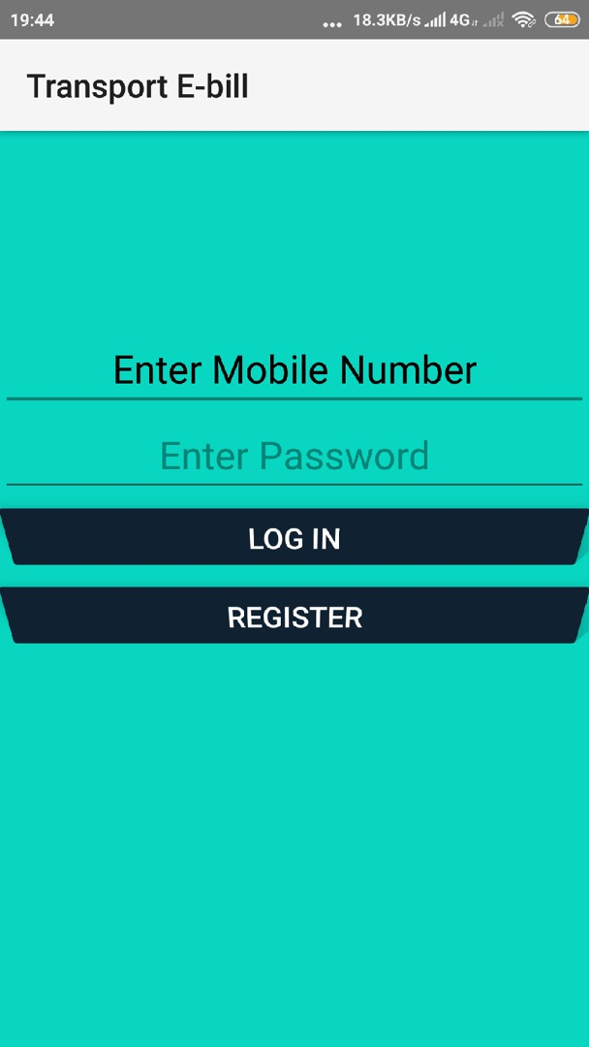
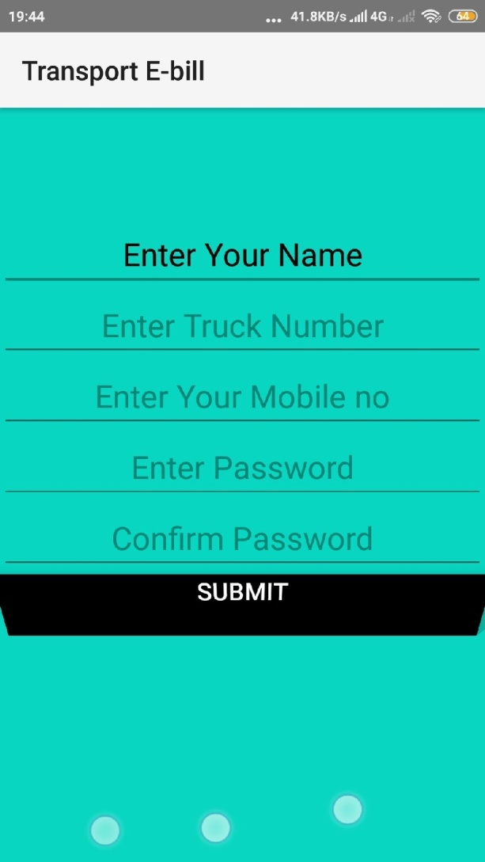
Design

Slide 10
Выполнение Графика /Schedule Accuracy
Past Accomplishments | Plan | Actual
<Task/Milestone> | DD-MM-YYYY | DD-MM-YYYY
Kick of Meeting | 04-03-21 | 27-02-21
SOW | 04-03-21 | 27-02-21
Future Milestones | % | Plan | Forecast
<Task/Milestone> | <n>% | DD-MM-YYYY | DD-MM-YYYY
Develop Project Management Plan (PMP) | 20 | 18-03-21 | 17-03-21
Notes:
Provide milestone tracking data in your own form used in project.
Use proposed table in case you have no special form for milestone tracking

Slide 11
Персональные Результаты / Personal Results Участник 1 / Team member 1
NAVEEN
Completed design of main activity and register activity .
Coding for 2 activities .

Slide 12
Персональные Результаты / Personal Results Участник 2 / Team member 2
Chubchik Alexander
Testing of application

Slide 13
Персональные Результаты / Personal Results Участник 3 / Team member 3
Ryleev Vladislav
Debug application

Slide 14
Проектная команда / Staffing

Slide 15
Риски и Проблемы / Risks and Issues
Lack of staff
Load of other tasks

Slide 16
Планы На Следующий Отчетный Период / Plans for future Reporting Period
Preparation for the Develop Project Management Plan (PMP)
Add some new activities
New Design for application

Slide 17
Thank You

